Slide 1
Depth Prediction
Without Sensor
PRESENTED BY Jiang Xuesong
2019/3/15
Casser V , Pirk S , Mahjourian R , et al. Depth Prediction Without the Sensors: Leveraging Structure for Unsupervised Learning from Monocular Videos[J]. 2018.
Zhou T , Brown M , Snavely N , et al. Unsupervised Learning of Depth and Ego-Motion from Video[J]. 2017.

Slide 2
Introduction
ONE
Traditional Way
TWO
CONTENTS
Loss Function
THREE
Network
FOUR

Slide 3
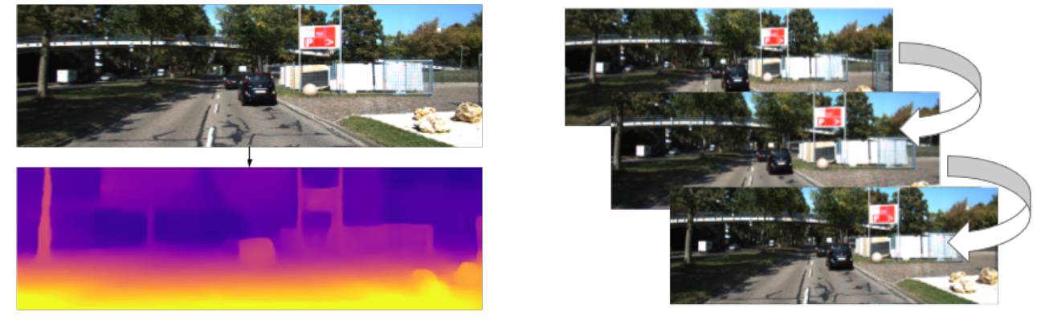
Introduction
Depth from video(RGB)
Self-train
Unsupervised learning of scene depth and robot ego-motion where supervision is provided by monocular videos
https://sites.google.com/ view/struct2depth.

Slide 4
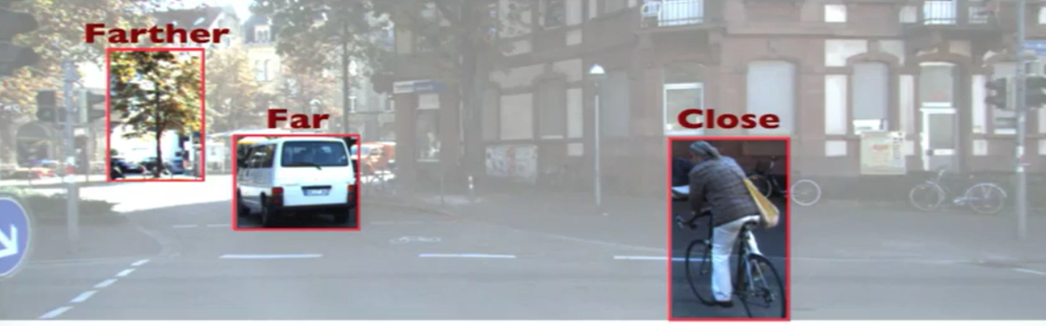
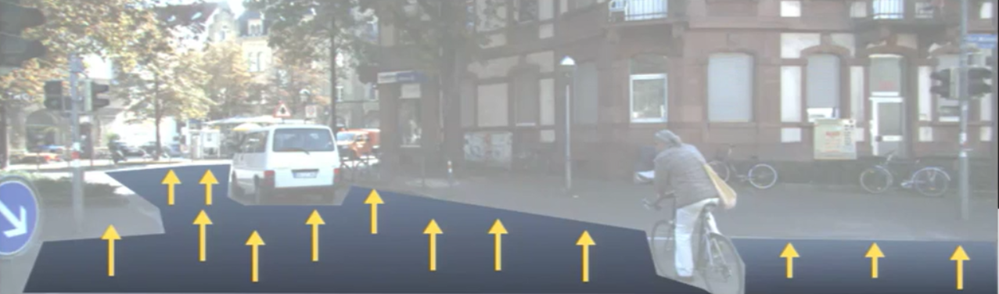
Introduction
Perception from RGB
How human percepts motion and depth

Slide 5
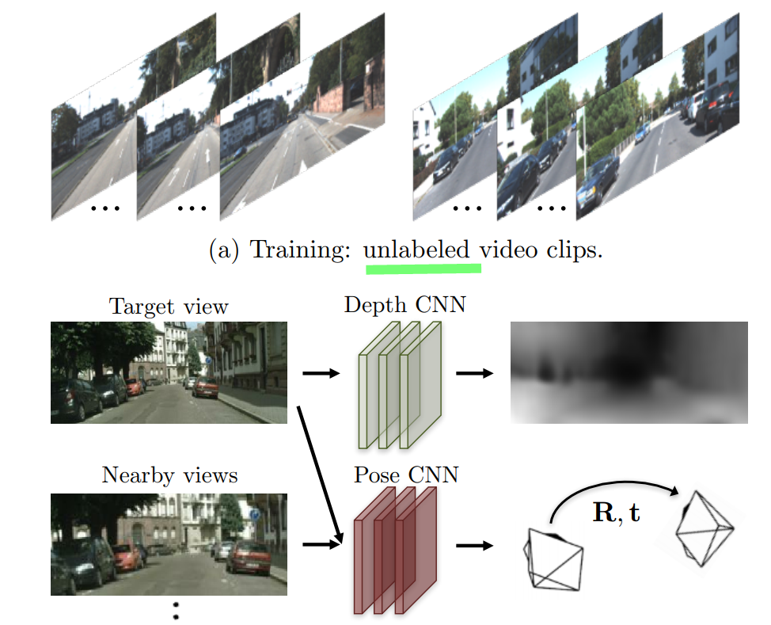
Introduction
How to train:
Unsupervised/Self-supervised
Finally get:
3D motions of moving objects
camera ego motion
online refinement

Slide 6
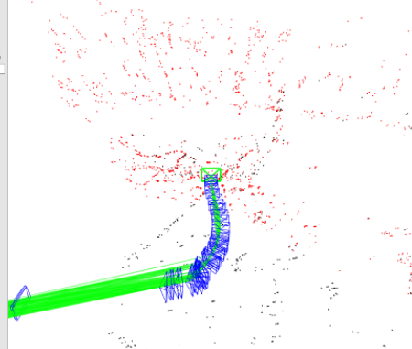
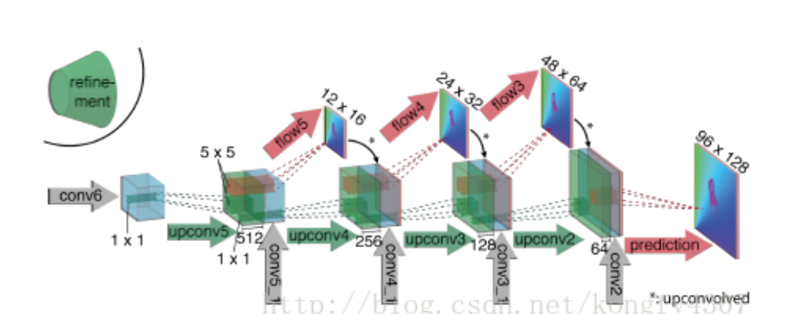
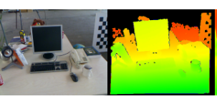
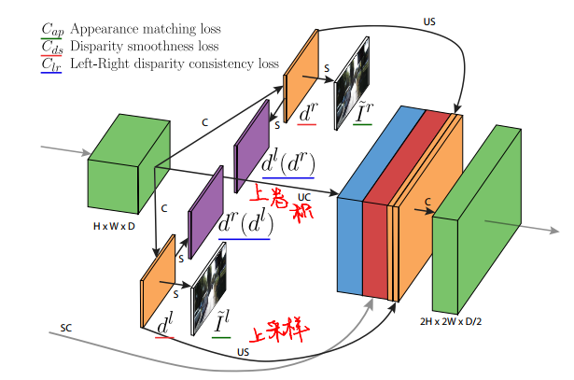
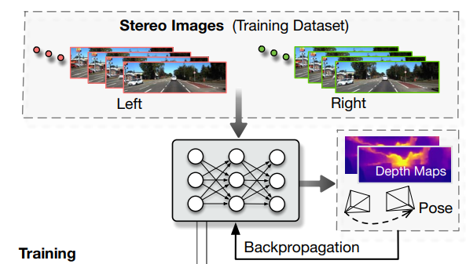
Traditional
ORB-SLAM2
Traditional Visual
Method
Flownet/DispNet
MVdepth
Supervised learning method
Monodepth
UnDeepVO
Frames in Different
Perspectives

Slide 7
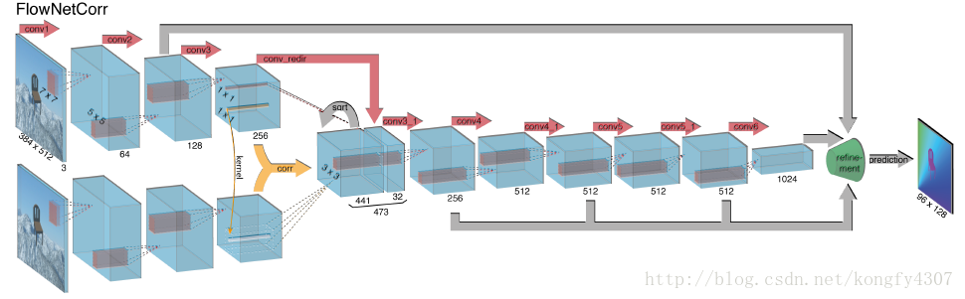
Traditional - Supervised learning
Mayer N , Ilg E , Häusser, Philip, et al. A Large Dataset to Train Convolutional Networks for Disparity, Optical Flow, and Scene Flow Estimation[C]// 2016 IEEE Conference on Computer Vision and Pattern Recognition (CVPR). IEEE, 2016.

Slide 8
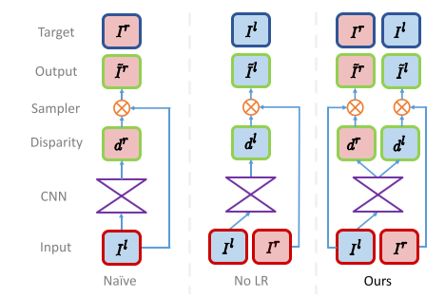
Traditional - Different Perspectives- L – R
Godard, Clément, Mac Aodha O , Brostow G J . Unsupervised Monocular Depth Estimation with Left-Right Consistency[J]. 2016.

Slide 9
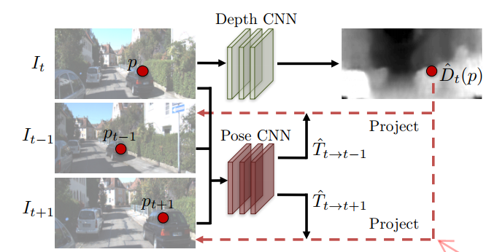
Loss Function-System Model
Jointly training
Loss

Slide 10
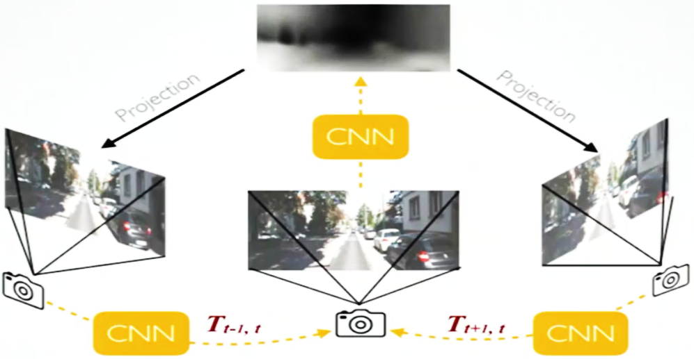
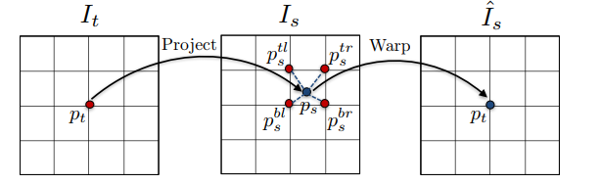
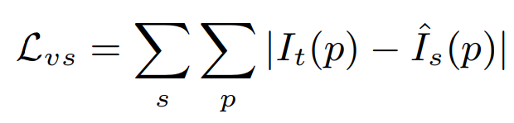
Loss Function-Baseline - Project
Warp function
Bilinear interpolation to fit the grid:

Slide 11
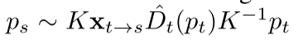
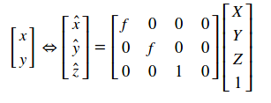
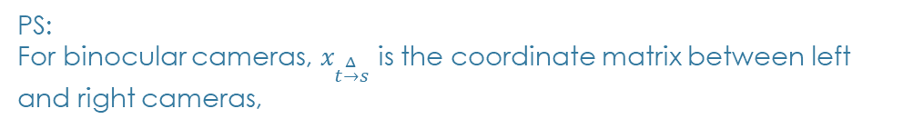
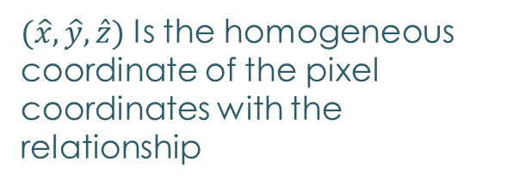

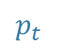
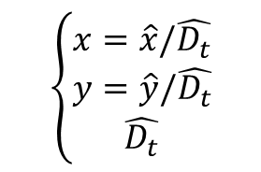
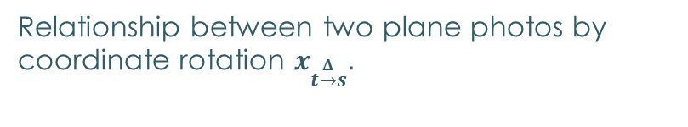
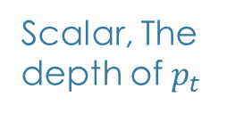
Loss Function-Baseline
Warp function
Scalar, The depth of $p_{t}$
$$K$$
World
coordinates
Pixel coordinates
$$p_{t}$$
World coordinates
$(\hat{x},\hat{y},\hat{z})$ Is the homogeneous coordinate of the pixel coordinates with the relationship
$$\left\{\begin{matrix}x=\hat{x}/\hat{D_{t}} \\ y=\hat{y}/\hat{D_{t}} \\ \hat{D_{t}}\end{matrix}\right.$$
Relationship between two plane photos by coordinate rotation $x_{t\underset{→}{Δ}s}.$
PS:
For binocular cameras, $x_{t\underset{→}{Δ}s}$ is the coordinate matrix between left and right cameras,

Slide 12
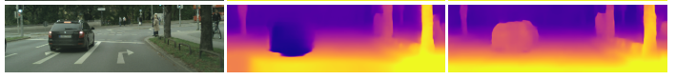
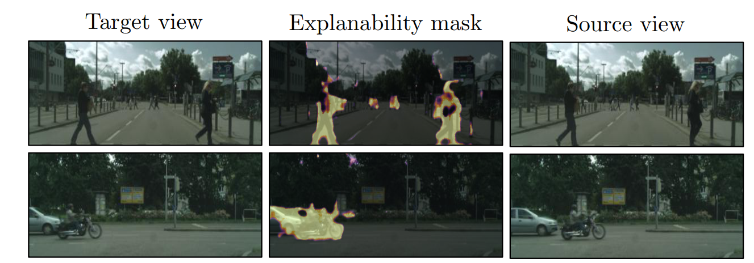
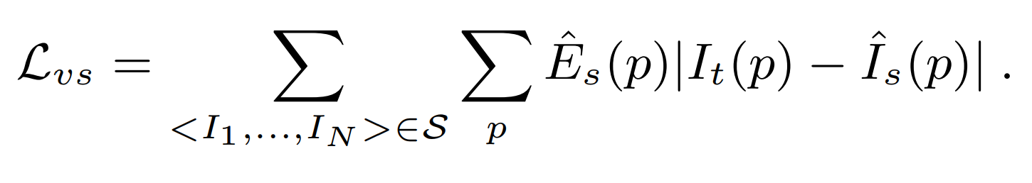
Loss Function-Baseline - corrected
Misalignment:
Moving Objects
Vehicles moving at constant speed are considered infinite
Segmentation masks:
PS: Regularization term encourages nonzero predictions

Slide 13
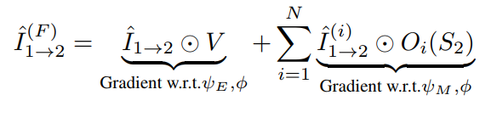
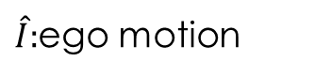
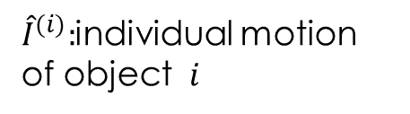
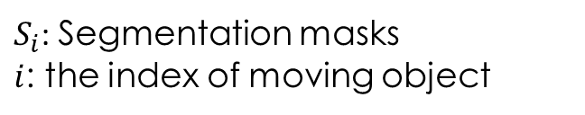
Loss Function-Motion
Problem:
Miss the part of moving object
${\hat{I}}^{(i)}:$individual motion of object $i$
$\hat{I}:$ego motion
Warp frame form
sequence 1 to 2
$S_{i}$: Segmentation masks
$i$: the index of moving object

Slide 14
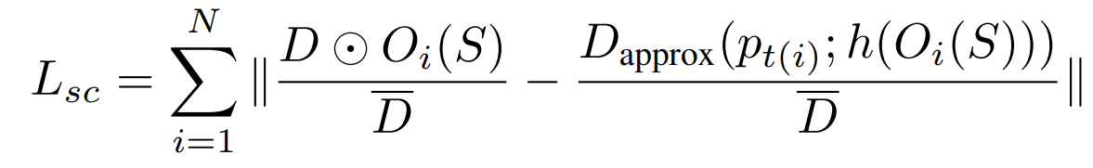
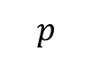
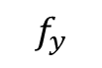
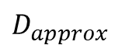
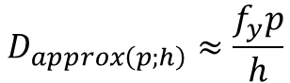
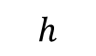
Loss Function - Object Size Constrains
Problem:
no knowledge about object scales:
placing an object very far away (Significant depth)
Moving at the same velocity
$$D_{approx\left(p;h\right)}≈\frac{f_{y}p}{h}$$
$$f_{y}$$
$$D_{approx}$$
$$h$$
Pixel
$$p$$
Method: learn objects’ scales as part of the training process

Slide 15
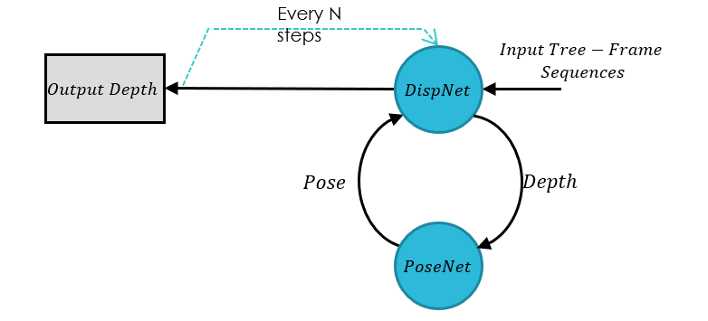
Loss Function - Refinement
The online refinement is run for N steps (N = 20 for all experiments) which are effectively fine-tuning the model on-the-fly;
The online refinement approach can be seamlessly applied to any model including the motion model described above.

Slide 16
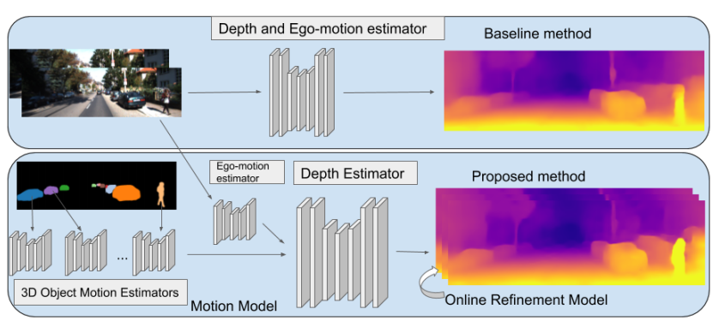
Network Architecture
Trained jointly
&
Test independently

Slide 17
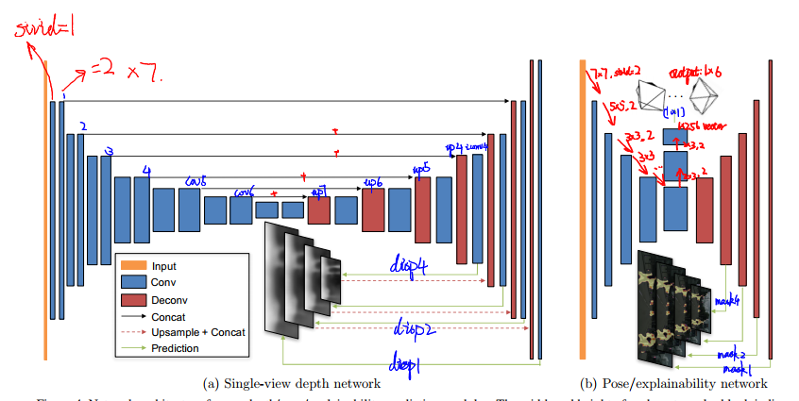
Network Architecture
N. Mayer, E. Ilg, P. Hausser, P. Fischer, D. Cremers,A. Dosovitskiy, and T. Brox. A large dataset to train convolutional networks for disparity, optical flow, and scene flow estimation.

Slide 18
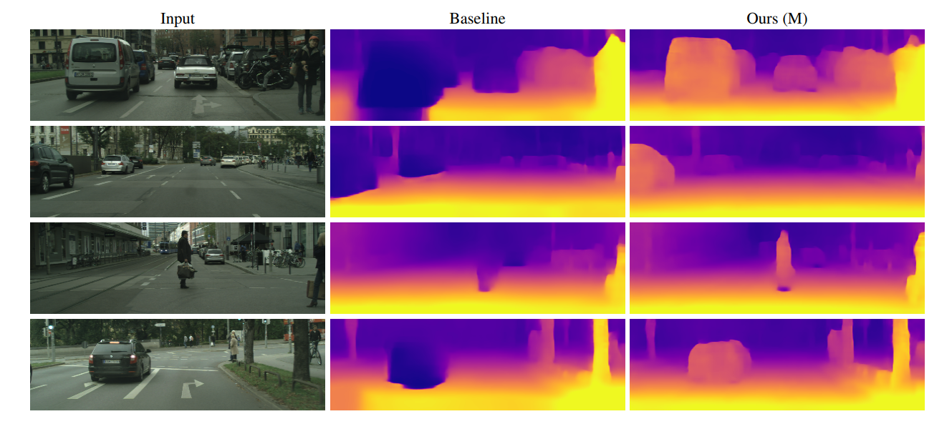
Experiment
Outdoor environment:
KITTI dataset (K)
Cityscapes dataset (C)

Slide 19
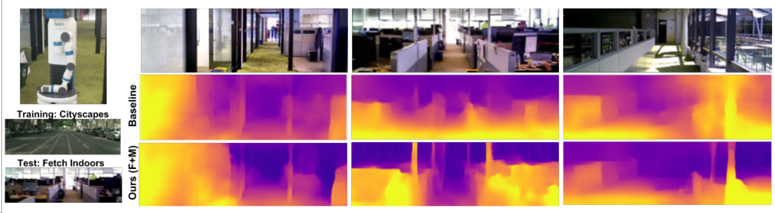
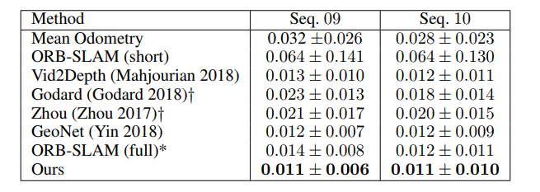
Experiment
Indoor environment:
Comparison of ego-motion:

Slide 20
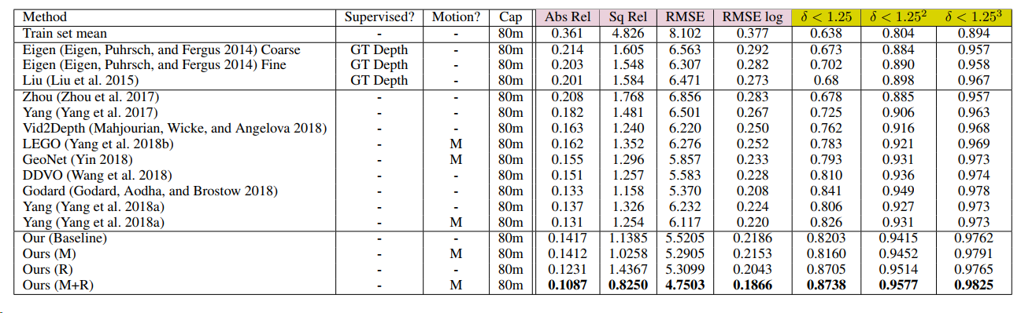
Experiment -Comparison
Yang Z , Wang P , Wang Y , et al. Every Pixel Counts: Unsupervised Geometry Learning with Holistic 3D Motion Understanding[J]. 2018.
Godard, Clément, Mac Aodha O , Brostow G J . Unsupervised Monocular Depth Estimation with Left-Right Consistency[J]. 2016.
Yin Z , Shi J . GeoNet: Unsupervised Learning of Dense Depth, Optical Flow and Camera Pose[J]. 2018.
Zhou T , Brown M , Snavely N , et al. Unsupervised Learning of Depth and Ego-Motion from Video[J]. 2017.

Slide 21
Q&A

Slide 22
THANK YOU FOR WATCHING
PRESENTED BY Jiang Xuesong

Slide 23
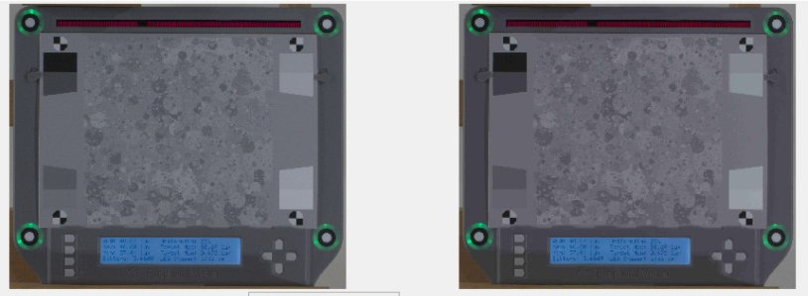
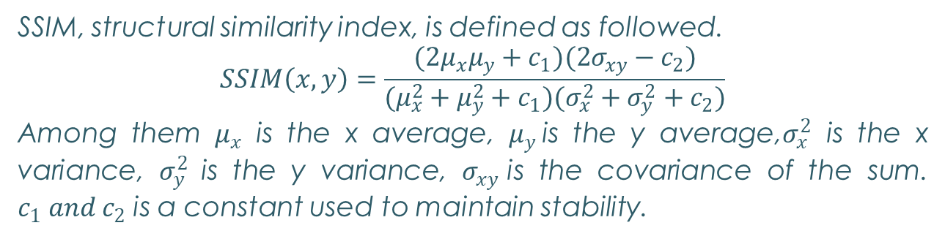
Reference-|SSIM|
Mainly used in Workpiece detection
SSIM, structural similarity index, is defined as followed.
$$SSIM\left(x,y\right)=\frac{(2μ_{x}μ_{y}+c_{1})(2σ_{xy}−c_{2})}{(μ_{x}^{2}+μ_{y}^{2}+c_{1})(σ_{x}^{2}+σ_{y}^{2}+c_{2})}$$
Among them $μ_{x}$ is the x average, $μ_{y}$is the y average,$σ_{x}^{2}$ is the x variance, $σ_{y}^{2}$is the y variance, $σ_{xy}$is the covariance of the sum. $c_{1} {and c}_{2}$ is a constant used to maintain stability.
Wang, Zhou; Bovik, A.C.; Sheikh, H.R.; Simoncelli, E.P．Image quality assessment: from error visibility to structural similarity：IEEE Transactions on Image Processing 13 (4)，2004-04-01：600–612

Slide 24
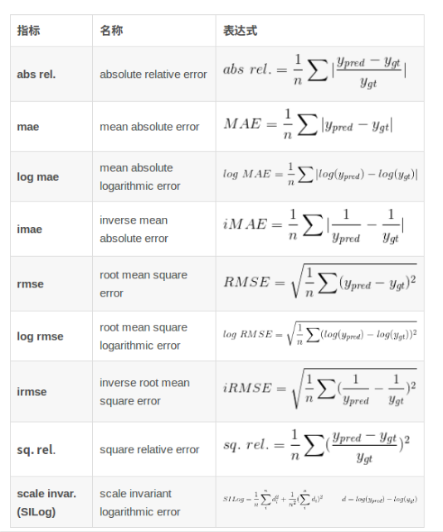
Reference

